Slide 1


Slide 2



Meet The Team
Hanna bajjaly
Natalie khoury
Wadie abu issa
.

Slide 3
Car tag

Slide 4
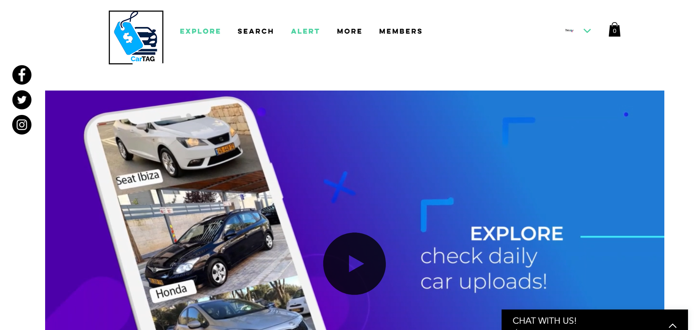
SERVICES
website
mobile

Slide 5
Why an
Online solution??

Slide 6
Keys
to Success
1
2
customer reassurance and support
customers convenience
our website provides the convenience that you don't have going physically to a car show room so that not only the customer can search the car model that he wishes to buy from our certified car show room but eventually other cars and accessories to buy
we can also provide a warranty period evaluated by the certified model mechanics that can assure the customers of the car expected conditions that he feels more comfortable to make the purchase
3
helping out the authorized show room marketing team
in addition we can widen the capabilities the the marketing team by applying marketing tactics using our online services for example purchasing a certain car can reward them with a certain gift relative of the car price not only that can attract the customers but to also make them feel connected enough that they stay loyal to the brand

Slide 7
Top Active car sellers applications or websites
90%
80%
70%
50%
60%
40%
Ebay motors
CarGarus
Auto trader
Facebook marketshare
Yad 2
Kelly blue books

Slide 8

Area Competitors
Facebook market share :
Yad 2 : 1 million downloads ++

Slide 9
Target Market
90%
Car show rooms
80%
Individual used car sellers
80%
customers

Slide 10

SERVICES
website
mobile

Slide 11
Sales & Marketing

Slide 12
Digital Marketing
Social Media
Email

Slide 13
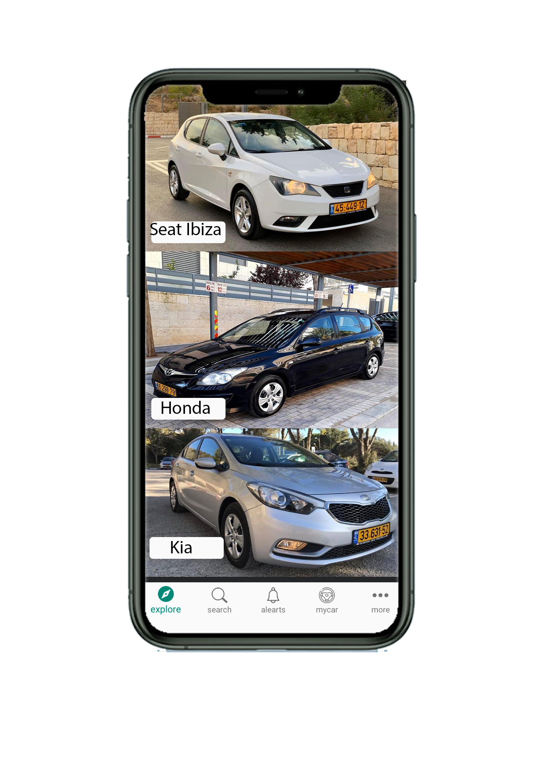
Explore , tab 1

Slide 14
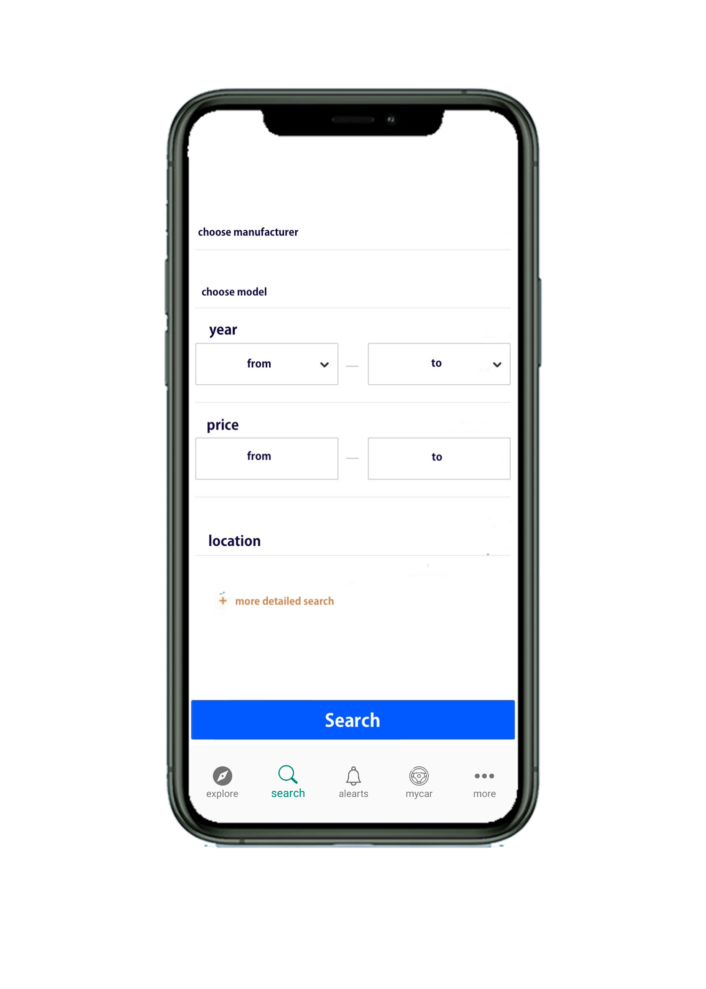
Search , tab

Slide 15
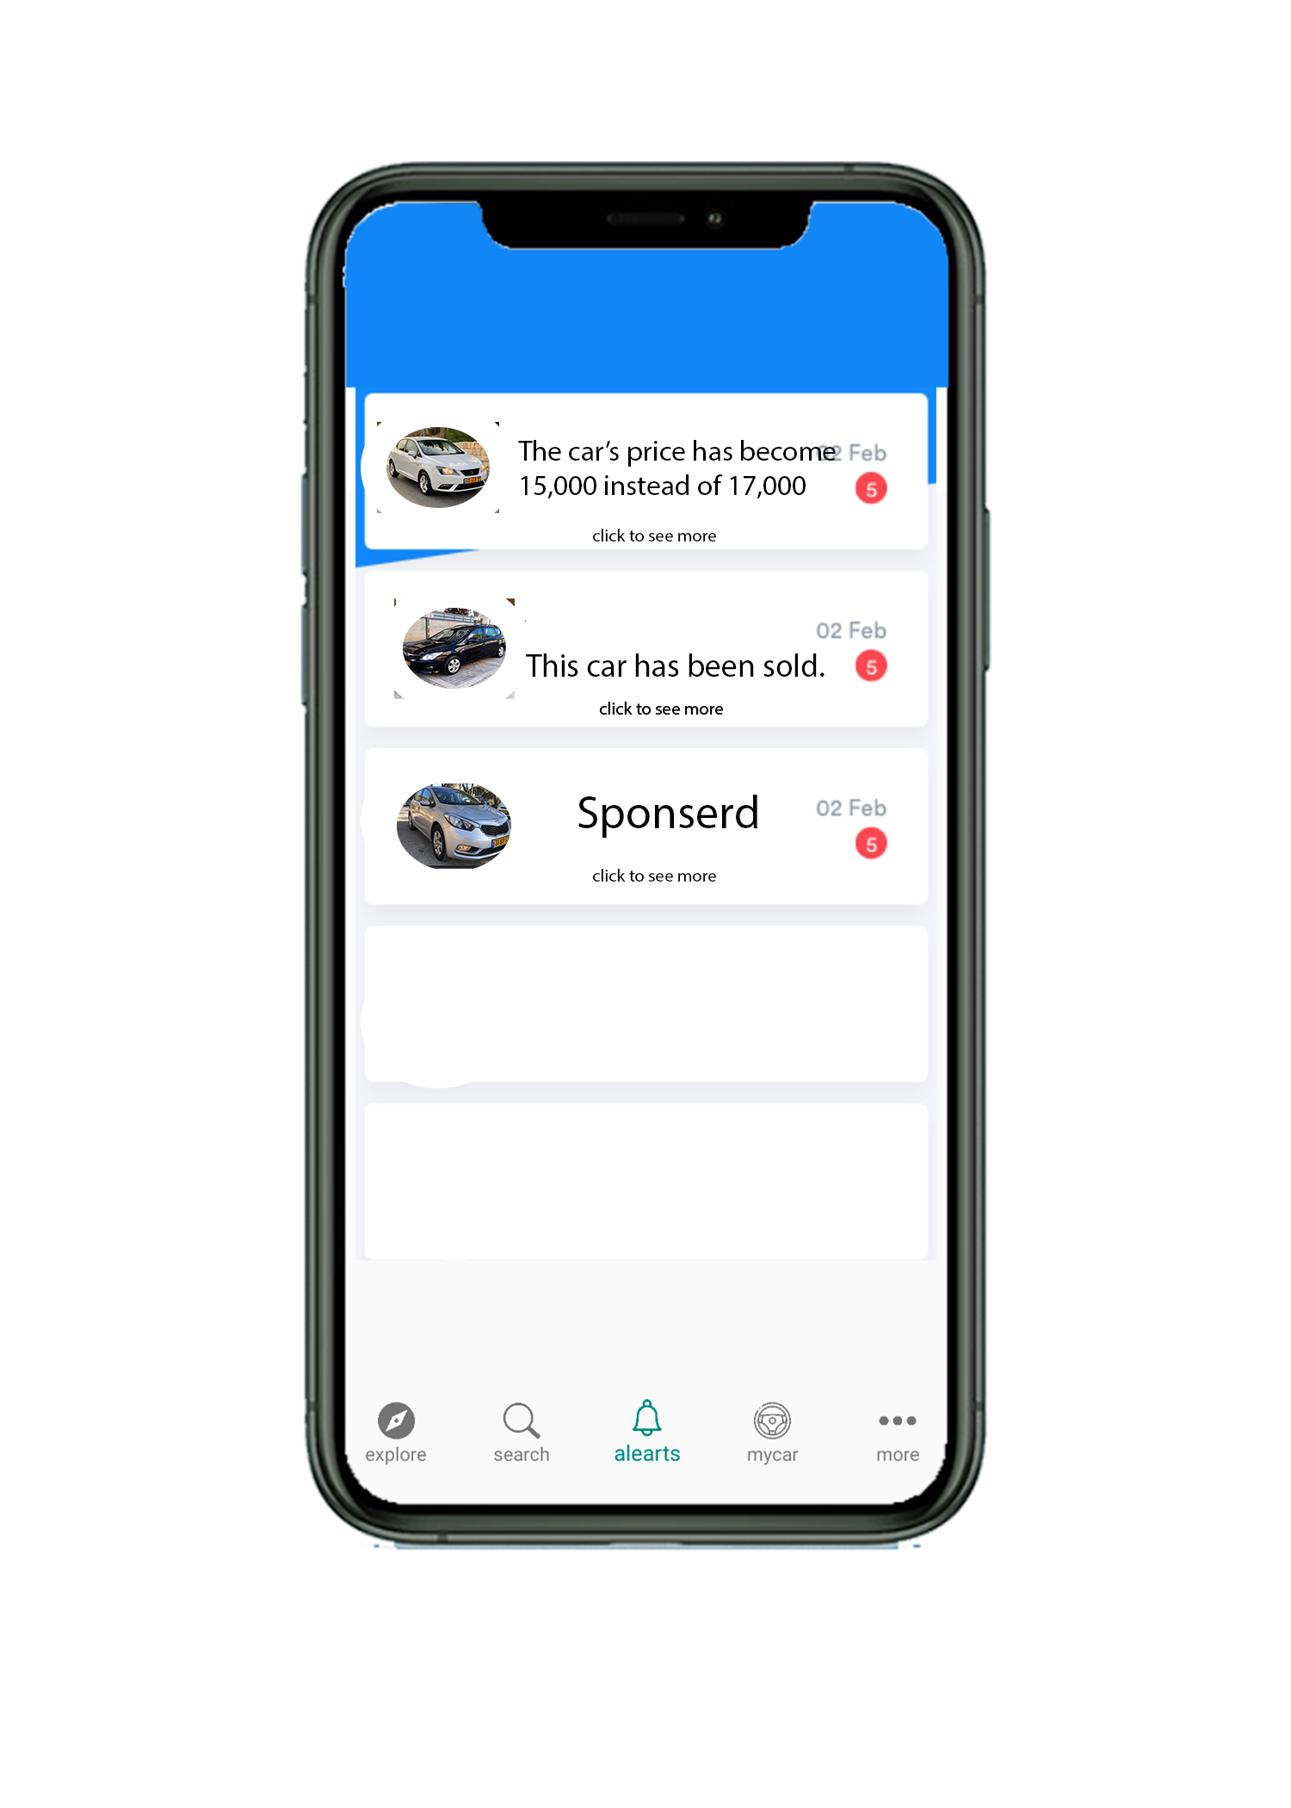
Alerts , tab

Slide 16
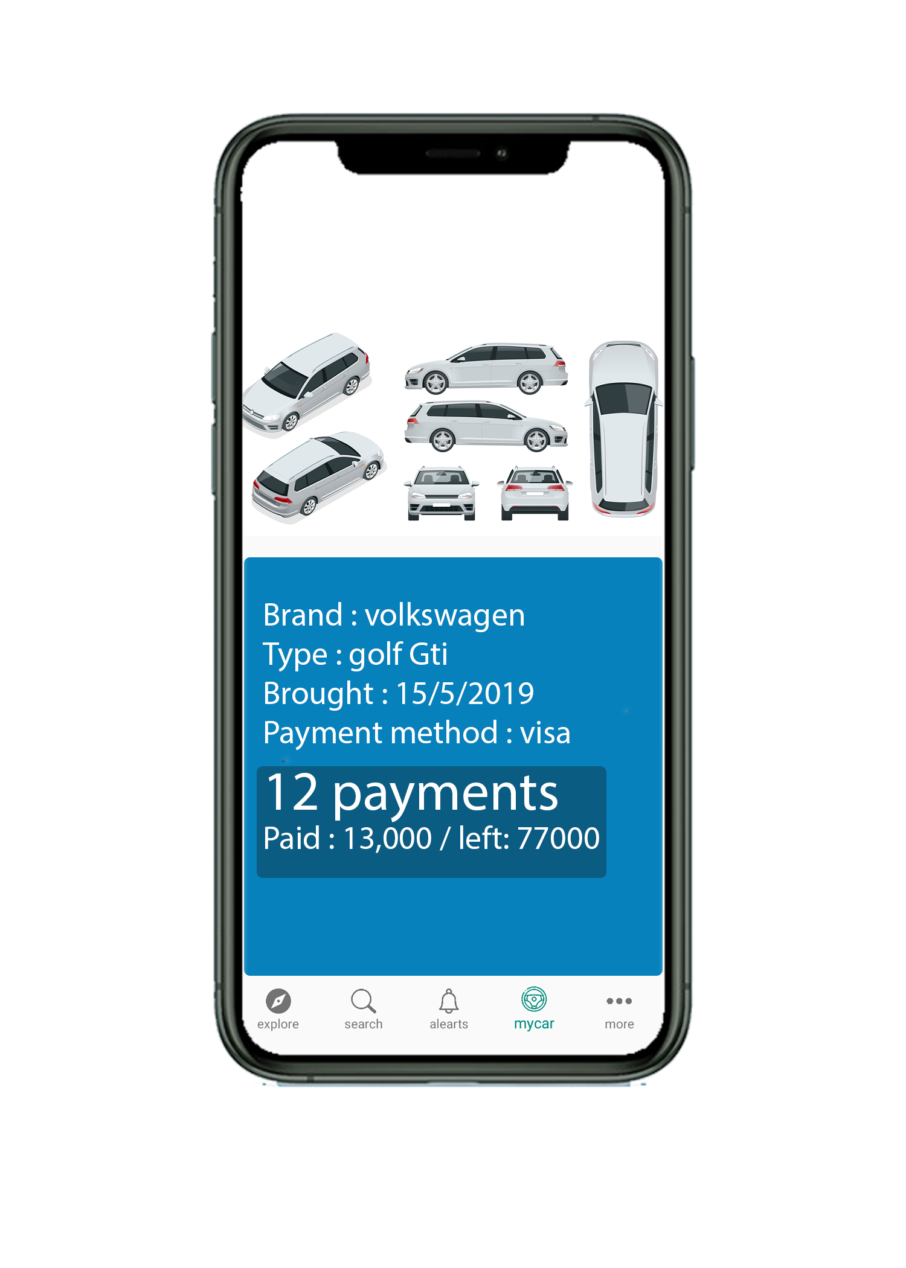
My car, tab

Slide 17




Favourite list
01
Car maintenence
More, tab
02
Car compare
03
Sales page
04

Slide 18
1
Favourite list
the favourite list contains the cars marked by the customer from the available cars in the show and provides updates on prices
2
Sales list
my coupons list represents the discounts and the gifts that the customer have been granted from using our online services and further decided by the car show room marketing team
3
compare
compare gives you the capability to compare different cars with different specifications that helps the customer have a quick understanding of which car fits his needs the most
4
Car maintenance
by valuing the car condition by the authorised show room they can give a warranty period that helps reassuring the customer of the purchase and to also help the customer if something goes wrong
More ,tab

Slide 19

Future vision

Slide 20
Team name : 404 found
THANK YOU !

